Slide 1
The Effects of Interpersonal Goals on Affect Valuation
Felicity F. Miao
Stanford University

Slide 2
Cultural Differences in
Affect Valuation
Chinese value calm > European Americans
European Americans value excitement > Chinese

Slide 3
Cultural Differences in Interpersonal Goals
In American culture,
  “Influence” Goals:
    They respect what I have to say
    I express myself openly
In Chinese culture,
  “Adjustment” Goals:
    Putting others needs before my own
    I conform to their expectations

Slide 4
Interpersonal Goals and Affect Valuation
Interpersonal
Goals
Culture
Affect Valuation

Slide 5
Interpersonal Goals and Affect Valuation
Interpersonal
Goals
Culture
Affect Valuation

Slide 6
Hypotheses
Influencers value excitement > Adjusters
Adjusters value calm > Influencers

Slide 7
Manipulating Interpersonal Goals
30 AA and 30 EA female participants
Jointly solve a puzzle
Conditions
  INFLUENCER
  ADJUSTER

Slide 8


Slide 9
Did the manipulation work?

Slide 10
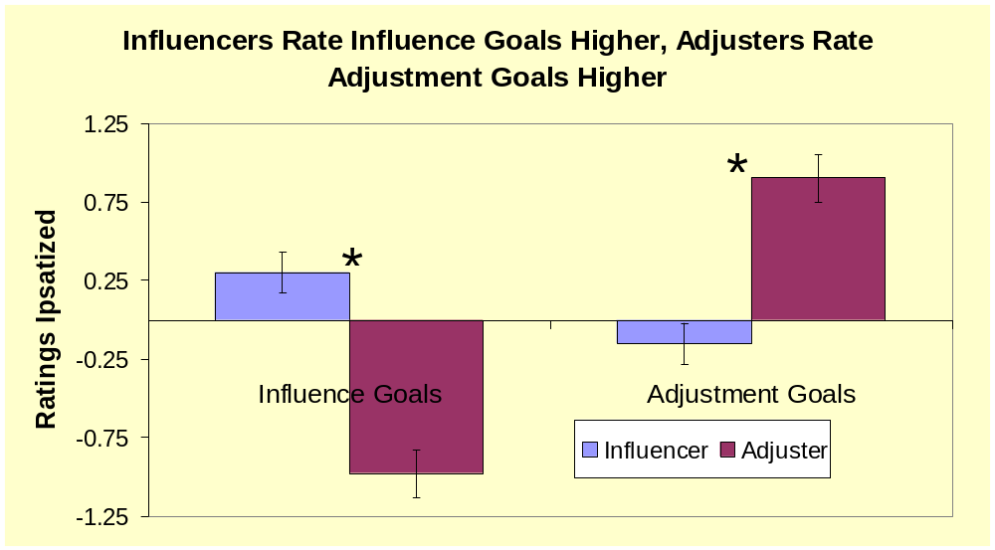
Felicity, Change to: Influencers Endorse More Influence Goals, Adjusters
Endorse More Adjustment Goals

Slide 11
Did Influencers and Adjusters Differ In Their Affect Valuation?

Slide 12
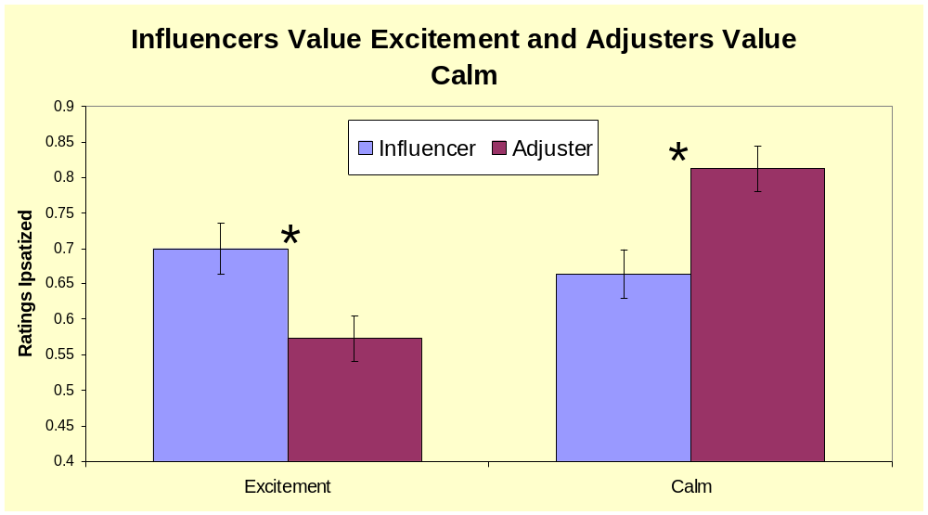

Slide 13
Summary
Influence goals are related to excitement
Adjustment goals are related to calm
Differences in interpersonal goals may account for differences in affect valuation

Slide 14
Two Implications
Affect valuation may vary situationally, as a function of interpersonal goals.
Cultural differences in affect valuation may be due to cultural differences in chronic interpersonal goals

Slide 15
Questions?

Slide 16
Measuring Ideal Affect
Now, please rate how much you would IDEALLY LIKE TO FEEL each of the following feelings and emotions NOW. Use the following scale:
1 2 3 4 5 6 7
Not at all Moderately Extremely
Enthusiastic Energetic Fearful Nervous
Dull Sluggish Calm Relaxed
Excited Motivating Harmonious Sad
Sleepy Quiet Peaceful Happy

Slide 17
